Slide 1
Deafhood to Artivism
Nancy Rourke

Slide 2
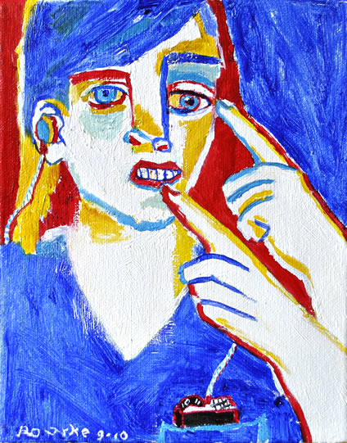
Really Deaf
Self portrait, 8x10inch, Oil on canvas
At that time, I did not know what the word ‘Deafhood’ meant.
The painting says I was colonized and submissive.
I explored my identity and painted different pictures while searching for Deafhood.
This is common for emerging De’VIA artists, while exploring self identity and then express in art.
Usually lasts one year before go on to the next genre.

Slide 3
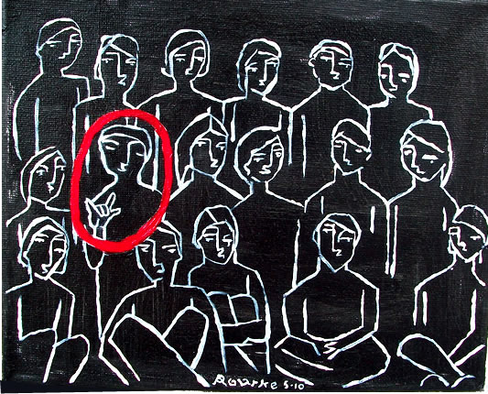
Isolation 8x10inch, oil on canvas
I started with
anger, denial
and frustration.
And suddenly, I became very
isolated.

Slide 4
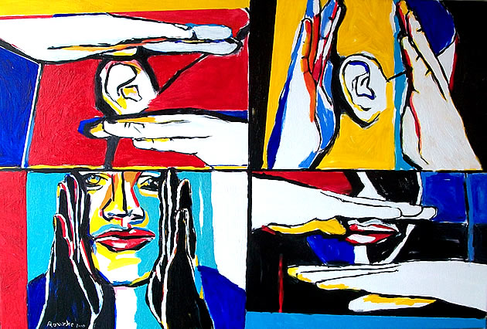
Audism, 20x30inch, Oil on canvas
This is the first
Audism painting.
This is when
I started to
open up more
and let out my
frustration from
oppression.

Slide 5
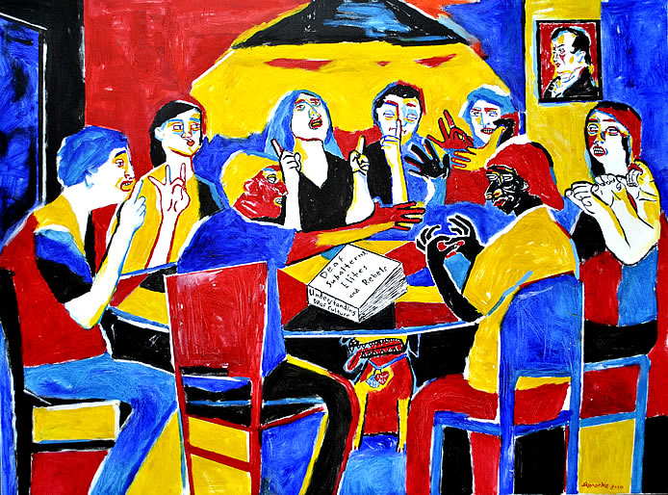
Understanding Deaf Culture, size 30x40inch, oil on canvas
Paddy Ladd’s book, Understanding Deaf Culture in Search of Deafhood,
helped me to
understand more
about Deaf Ethnic
and oppression.

Slide 6
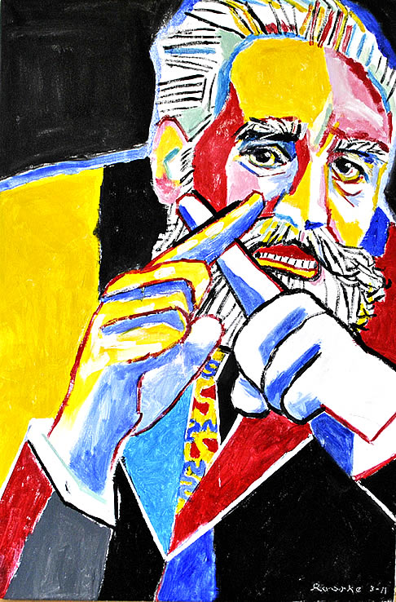
Misguided Benevolent
20x30inch, oil on canvas
This is when I started learning more about Alexander Graham Bell.
With his fingers signing ‘X’, he is saying, “Stay away from me. I didn’t do anything bad.”

Slide 7
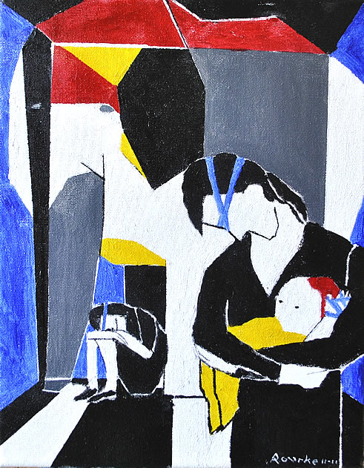
The Elephant in the Deaf Room 11x14inch, oil on canvas
The elephant is Alexander Graham Bell in a tiny Deaf room with blinded parents of Deaf children in the corners of the room who are stressed out with anxiety and fear. They have been blinded, unable to see what is happening in the room. Unable to see that Alexander Graham Bell and his associates are hurting their Deaf babies.
'The elephant in the room' (idiom)- a major or controversial problem that is not discussed.

Slide 8
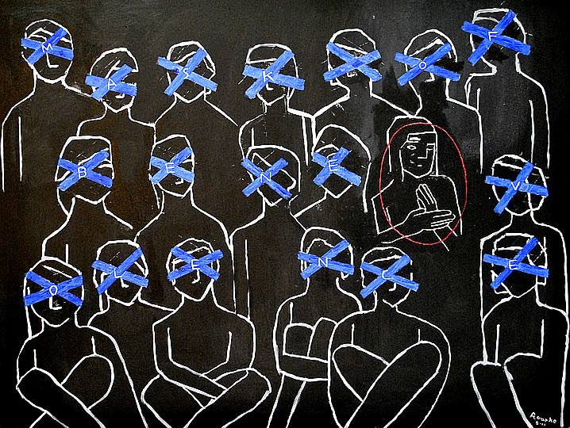
Mask of Benevolence
30x40 inch, oil on canvas
I learned about
the blue tape
from Audism Free
America in
Washington, DC, 2011.
I used blue tape in this painting.
Symbol in painting:
BLUE TAPE
Definition:
Audism
ASL prohibited
Trapped
Labeled
Tied-down

Slide 9
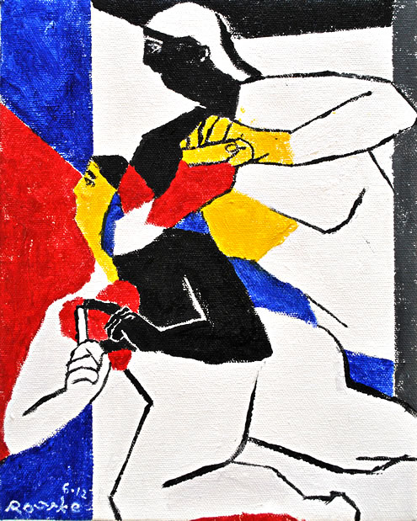
Truth Seekers
8x10inch, oil on canvas
De’VIA artists are
truth seekers.
What they see,
they paint the truth.
The truth goes out to the community.

Slide 10
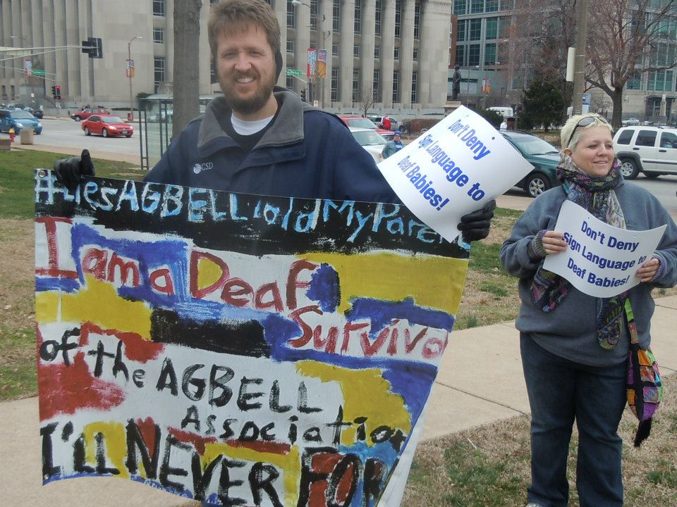
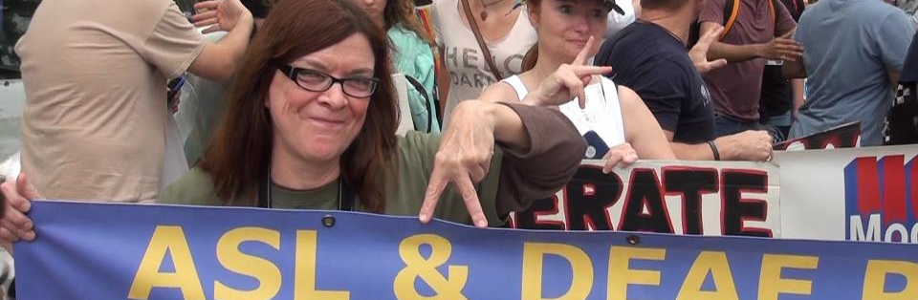
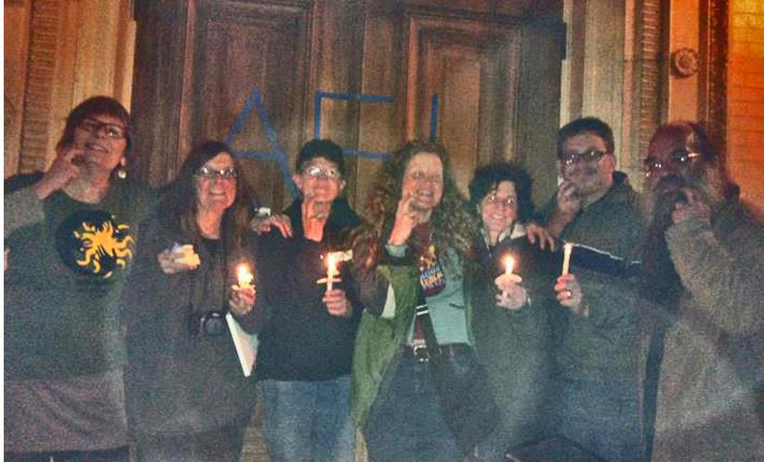
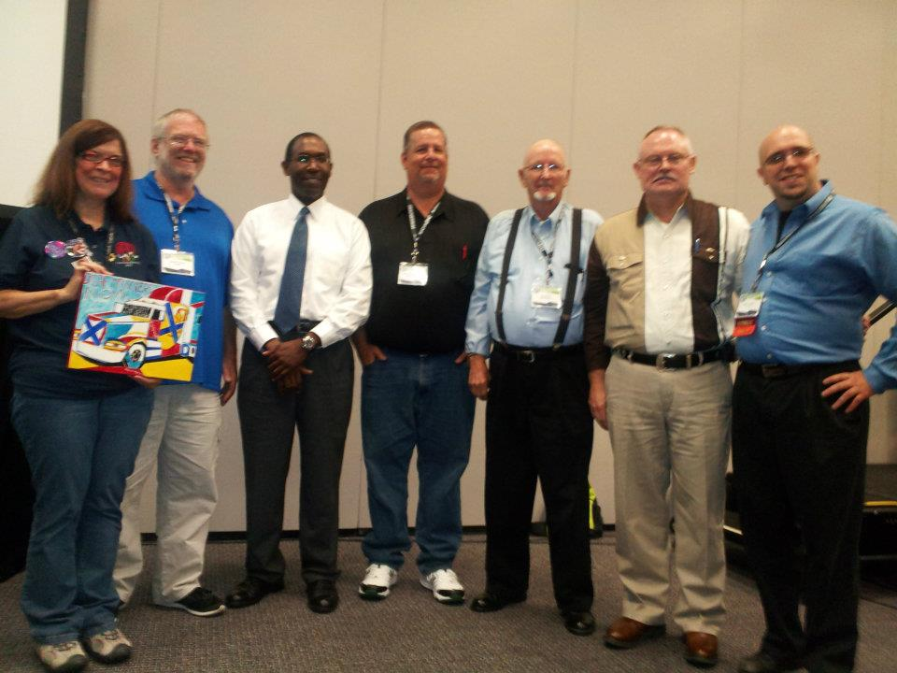
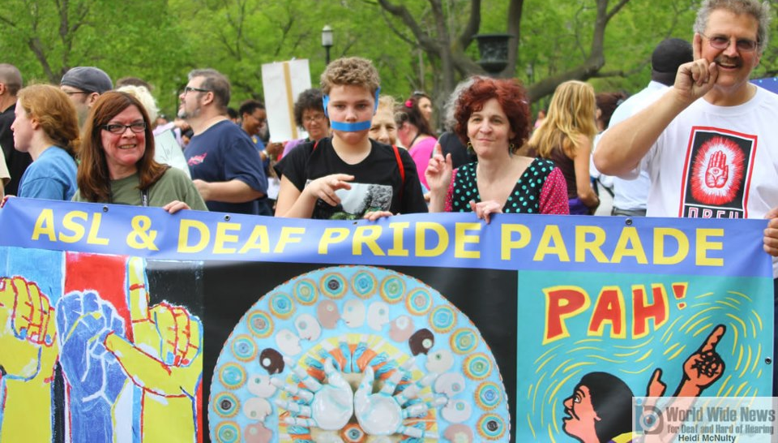
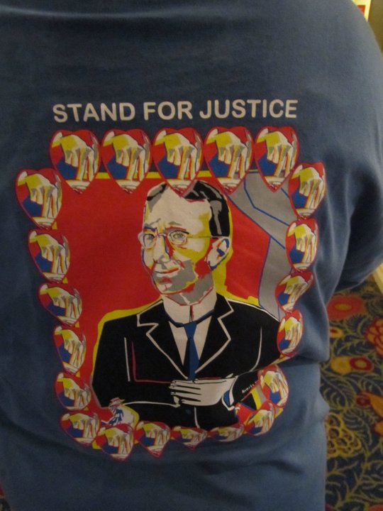
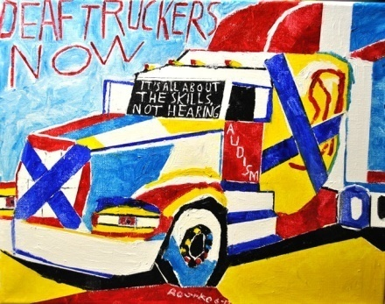
Using ART and being ACTivists, De’VIA artists become ARTivists.

Slide 11
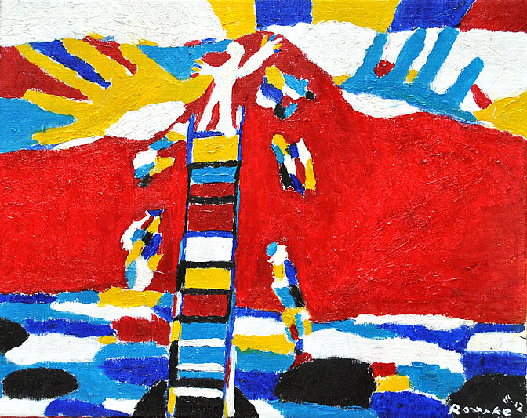
De'VIA has become viral since Deafhood was mentioned in the book Understanding Deaf Culture in Search of Deafhood. And because Oralism has been constantly invading, Paddy Ladd said, we have a few years left to keep building the mountain.
COLOR ASL, 11x14, oil on canvas
This painting has two themes. Affirmative and Resistance Art. To combine that, it is a Liberation Art. This is inspired by infamous ASL poet, Debbie Rennie,
"Black Hole: Color ASL." The red mountain came from Paddy Ladd's quote, about a growing mountain overcomes Audism. The black holes, dots and water represent Audism, Oralism and AGBell. The ladder represents a path that leads you to a new Deafhood journey. A Deaf artist is at the top of the ladder, spattering colors of paint into the sky. The colors drip to the water, and black paint becomes black holes. The black holes are the Audism, trying to take away a Deaf identity and Deaf Culture. The ladder is slowing draining into the black hole.
What happened to the Deaf artist?

Slide 12
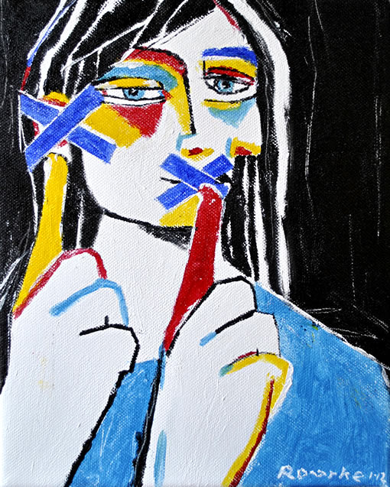
Deaf and Proud
8x10inch, oil on canvas
This painting is about being proud to be Deaf. The Blue Tape symbol represents the meaning of tied-down, trapped, crossed-out, mask of benevolence, labeled, ASL prohibited and Audism. The Blue Tape on the mouth and ear means 'Leave us alone.' It means 'Do not mess around my Deaf ears and mouth,' 'Do not fix my Deaf ears,' 'I am fine without learning to speak.' To summarize it, this is to say, do not touch my ears and mouth, I am proud for what I am, Deaf. There is a smile behind the blue tape over the mouth.
The red finger means power.
The yellow finger means hope.

Slide 13
De’VIA
in St. Petersburg, Russia

Slide 14
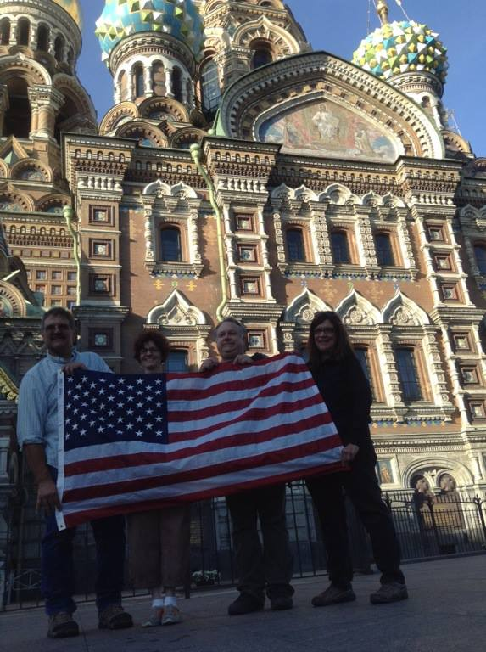
Five USA Deaf Artists
went to Russia for the
Deaf International Art Exhibition.

Slide 15
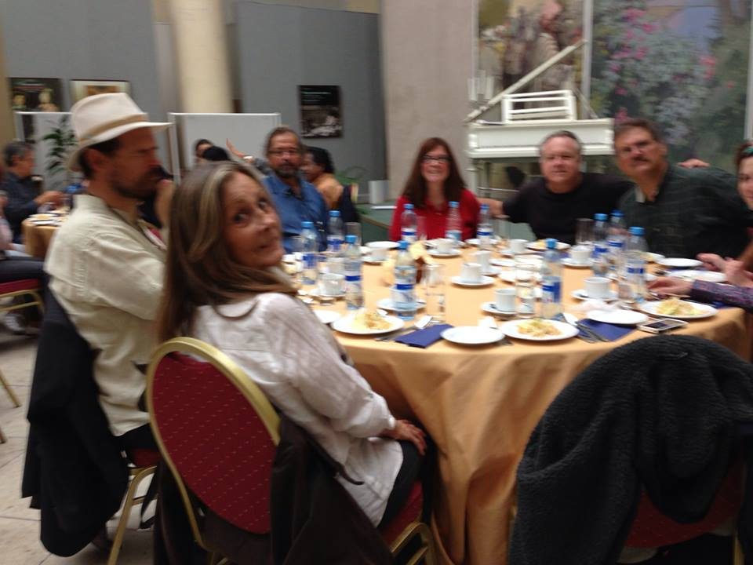

Slide 17
Ellen Mansfield’s illustration

Slide 18
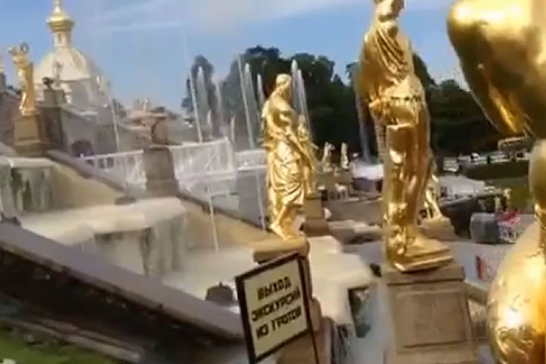

Slide 19
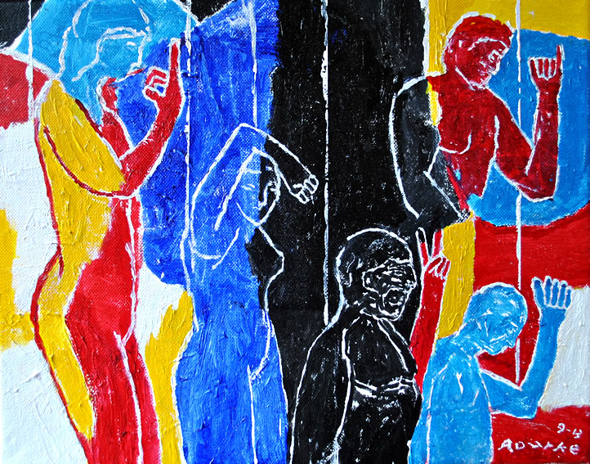

Slide 20
Nancy Rourke’s painting

Slide 21
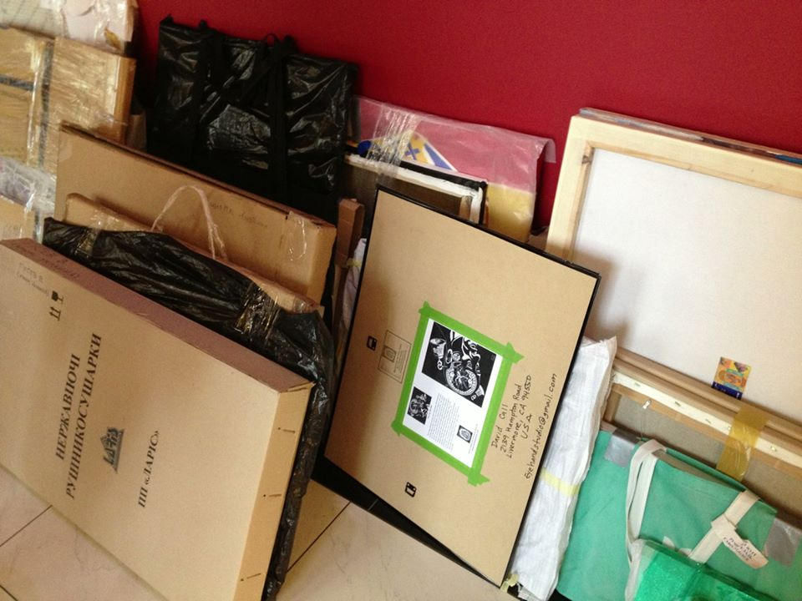
There were 158 artworks at the Art Exhibition.

Slide 23
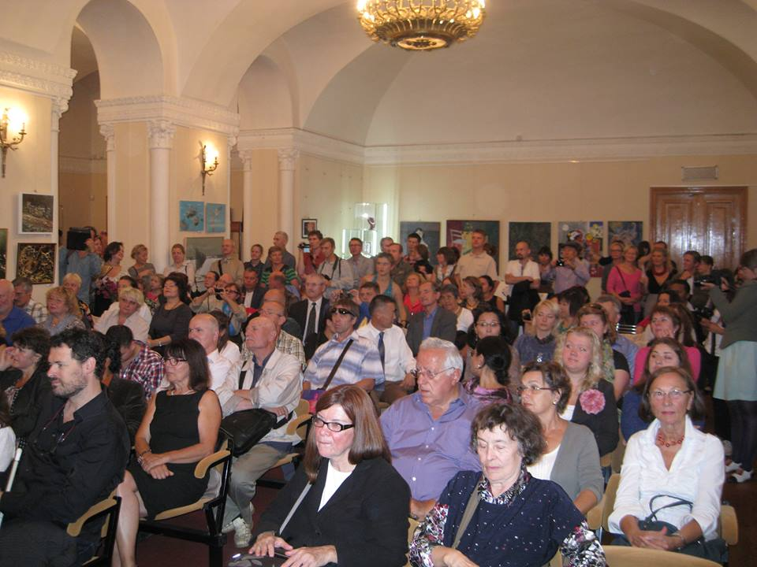
There were 86 Deaf artists and some 100 plus visitors.

Slide 24
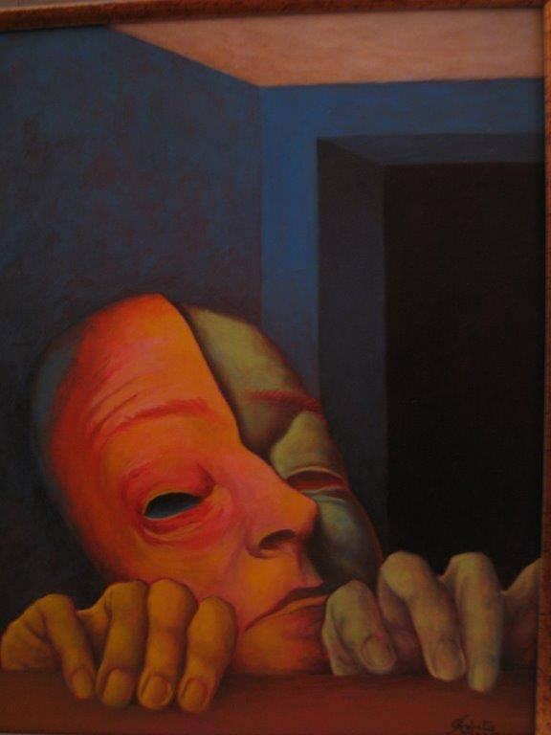
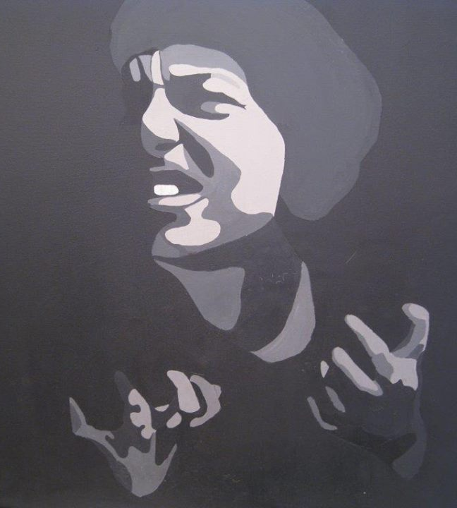
There were only two similar De’VIA themed work done by International Deaf Artists.

Slide 27
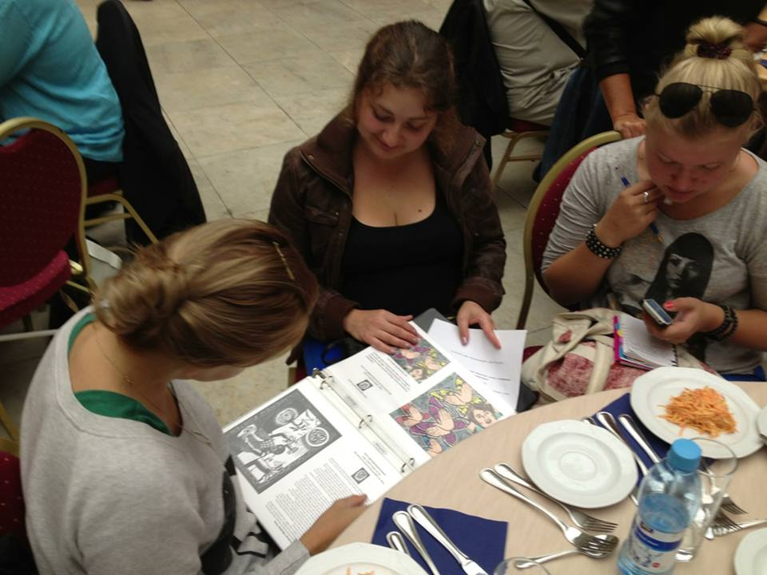
There are younger group of Deaf Russian Artists who are very interested in learning about De’VIA.

Slide 28
See Nancy Rourke YouTube Russia vlogs.
Part I
Part II
http://www.youtube.com/watch?v=qaBIKnczsiY
http://www.youtube.com/watch?v=7AK4fBMNNbg
http://www.youtube.com/watch?v=Ugo15urRgPk
Part III
Part IV
Part V
http://www.youtube.com/watch?v=kSwlEHq3uZQ
http://www.youtube.com/watch?v=aMGZumFooYA
http://www.youtube.com/watch?v=w01pVI0q1HI
Part VI
http://www.youtube.com/watch?v=wSTem_NLiko

Slide 29
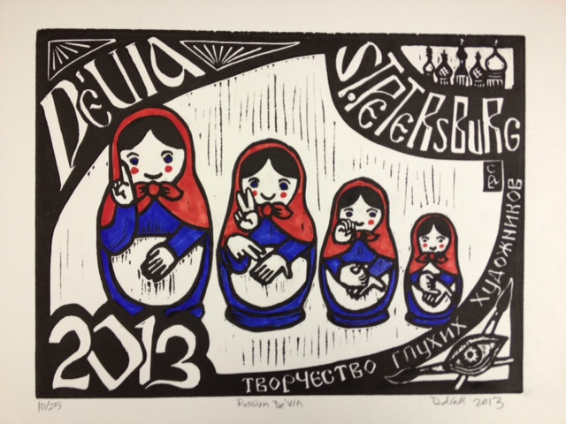
David Call’s linocut
Thank you for watching.
Deafhood to Artivism - NTID’s 45th Anniversary 2013

